Slide 1
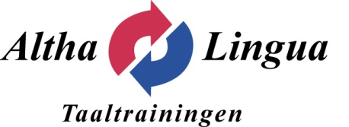
TaalAudit
Determine the actual language skills of your (future) co-workers
By means of the Telelangue online tool you can quickly assess your co-worker’s language skills. The assessment establishes the level of the language according to the Common European Framework of Reference for Languages (CEFR).
Quick to do and suitable for every function.
The co-worker completes the 30 minute evaluation via the internet, including:
*A test which will be adjusted to the level of your future collaborator therefore guaranteeing accurate results;
*A series of questions about vocabulary, grammar and listening skills to establish the current language level of the co-worker;
* A list of questions regarding goals, previous education and the required professional language skills will be accumulated and analysed.
Substantial saving of time
A unique method offering the possibility of administering linguistic skills both locally and internationally in a short period of time.
*Multilingual user interface: English, Spanish, German, Italian, Dutch, Korean, Russian, Chinese and simplified Chinese, Portuguese (Portugal and Brazil), Japanese, Bulgarian, Turkish;
*An audit to test 8 languages: English, German, Brazilian, Spanish, French, Italian, Dutch, Portuguese;
*The results from the language audit will be supplied:
- within 48 hours via Altha Lingua
- within 30 minutes via Net Reporting (direct access to test results via the Net Reporting function).
Easy to use and confidential
* No installation required only an audio card and headphones;
* Easy to order tests via Altha Lingua;
* The names of the tested co-workers are only known by you. Altha Lingua acts merely as a go-between and has no access to the names of your personnel.
Fantastic value for money
* A sample test can be ordered for 20,00 (excl. VAT)
* 45,00 (excl. VAT) per test
* Buy in bulk benefit: 15% discount for 50 tests
* Optional: first time buyer Net Reporting: 200,00 (excl. BTW).
Altha Lingua has extensive experience in the development and execution of professional language training courses, and is constantly seeking new learning methods and language products in an ever demanding market. For this reason Altha Lingua has become a distributor for The Netherlands for Language Audit products from Telelangue, a worldwide organisation specialised in linguistic assessments. Telelangue has been awarded amongst other things the European “Hermes Innovation Prize”.
ALTHA LINGUA Taaltrainingen Middenweg 135 1462 HH Middenbeemster
Telefoon: 0299 - 69 05 08 Internet: www.altha.lingua.nl
e-mail: info@altha-lingua.nl

